Slide 1
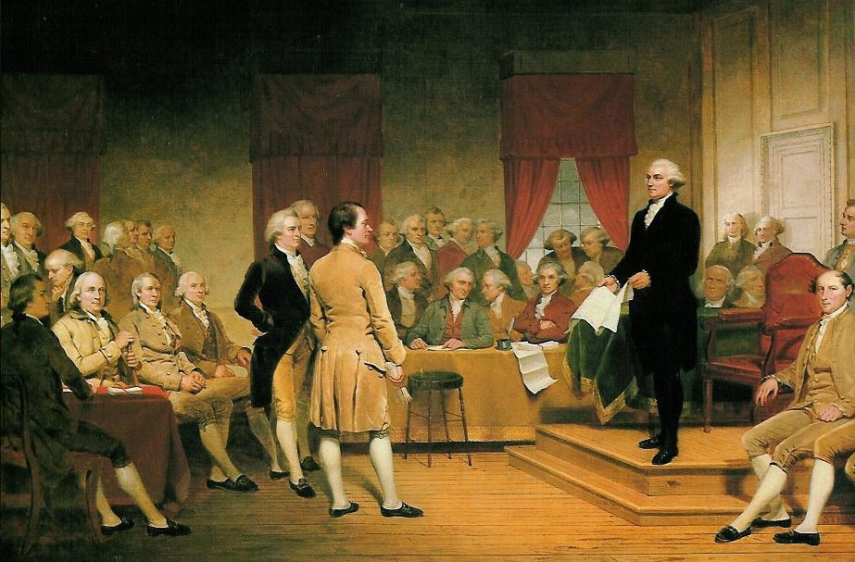
Ratification
Gotta Pay the Cost to be the Boss

Slide 2
Targets

Slide 3
Questions to Ponder
To what extent were the compromises reached the result of 18th century Republican ideals held by the delegates and to what extent were they the result of deep-rooted economic and political interests of the regions the represented?
Double standard for slaves?
Difference in status, military service, region, experience for Fed/Anti-Fed? Why?

Slide 4
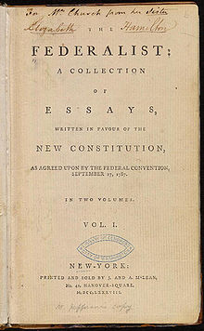
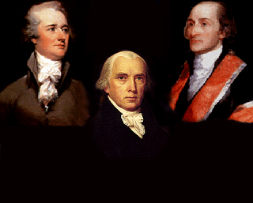
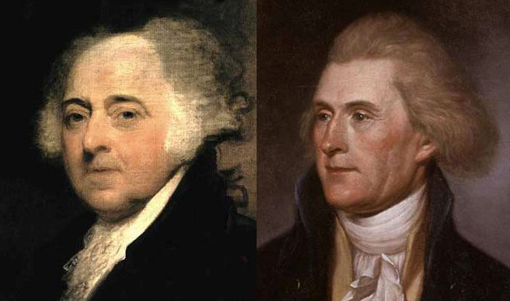
Federalists vs. Anti-Federalists
Federalists – Northerners Jay, Madison, Hamilton
Upper class, gov. should regulate commerce, taxes
Madison argues for big gov. to be more successful w/ checks and balances
Small States – Happy w/ Senate compromise
More political experience; high ranks in AmRev
Anti-Federalists – Southerners who feared a legislature filled by rich, high-born Northerners→ abuse ind. rights
Less political experience; lower ranks in AmRev
Fought for freedom, so don’t want to lose it→ Bill of Rights
Vs.

Slide 5
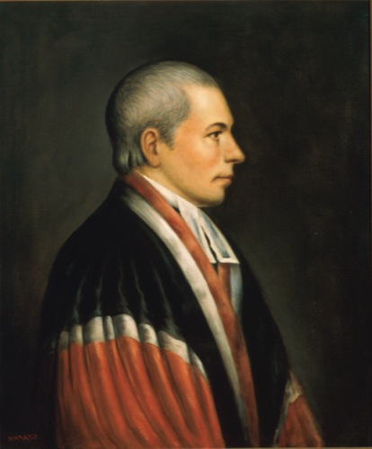
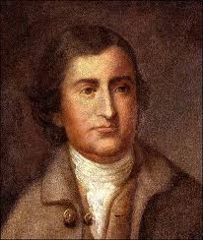
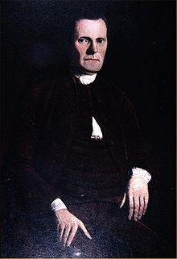
Compromises
Virginia Plan – Representation in legislature based on population
New Jersey Plan – = Rep for each state
Connecticut Compromise – Bicameral legislature with one of each (= in upper house)
3/5 Compromise – How do we count slaves?
Paterson
E. Randolph
Sherman

Slide 6
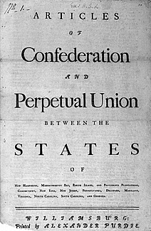
Better than the Articles of Confederation? Yes.
State gov. w/ no relation to citizens→ Senate/House w/ = power and responsibility to people
No court hierarchy→ Fed Courts regulate congress
Single congress of delegates→ 3 distinct branches with checks, balances, and well-defined roles
X

Slide 7
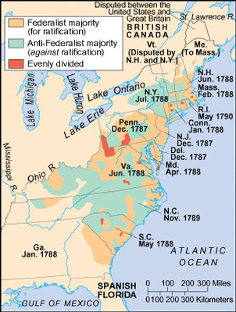
Ratification Timeline
Nine needed to ratify
State conventions to ratify. Why?→ evades political machines, authorization comes from people
Needed PA (12/1787), MA (2/1788), VA (6/1788), NY (7/1788) to be valid/trusted
After ratification, Washington elected President
NC (11/1789) and RI (5/1790) last holdouts

Slide 8
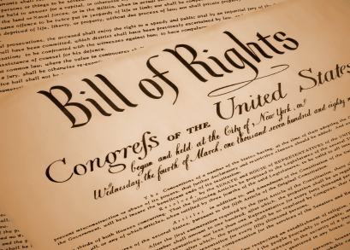
Bill of Rights?
Argument For – Protect and enumerate the rights of the people; English did it.
Argument Against – Constitution is strong enough without it. Ineffective against Republican gov. b/c it’s too narrow and could serve the exact opposite purpose for which it was designed.

